Slide 1
911 Call Overview

Slide 2
Overview
Some Brief History
911 Calls Today (Overview)
911 Calls Today (Workflow)
Landline Calls
Wireless Calls
Phase 1
Phase 2
Police, Fire, and/or EMS?
Police, Fire, and/or EMS? – Part 2
Dispatching
Recommends
Officer initiated actions
Follow Up – D, F, and E codes
So, how is the website populated?

Slide 3

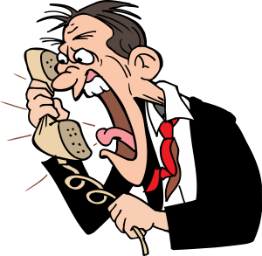


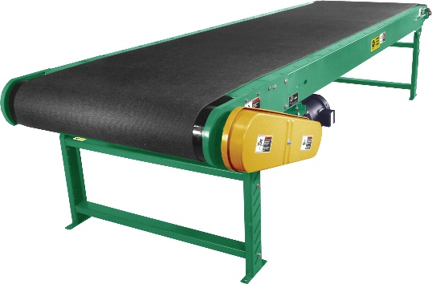
Some Brief History
In the beginning…. 1968

Slide 4

911 Calls Today (Overview)

Slide 5

911 Calls Today (Workflow - Landline)
ANI/ALI

Slide 6
911 Calls Today (Workflow - Wireless)
Phase 1 Tower Address
Phase 2 GPS Location

Slide 7
Police, Fire, and/or EMS?
Caller calls in Accident no injuries
Problem type set to ACC2 – MVC No Injuries
CAD is preset to create Police “Card” with ACC1 problem type
Low Priority, call taker ends call, at the same time, the dispatcher will dispatch when resources become available
Caller calls back, smoke beginning to emit from one of the vehicles
Problem type changes to FROAD – Vehicle Fire
CAD is preset to create Fire “Card” with FROAD problem type
Before caller hangs up, he reports that someone inhaled the smoke and is having trouble breathing.
Problem type changes again to INHAL – Inhalation Injury
CAD is preset to create EMS “Card” with INHAL problem type
Police
Call Taker
EMS
Fire

Slide 8
Police, Fire, and/or EMS? – Part 2
Caller calls in with someone having trouble breathing
Problem type set to Trouble breathing, EMS Card created automatically and EMS is dispatched
Call taker is prompted with questions to ask – Is the person breathing at all? Caller reports user is occasionally gasping for air
Small note, if this actually happens IRL, do not confuse this for actual breathing
As call taker inputs victim isn’t breathing, a fire card is created
Depending on the recommends, Police may be dispatched as well.
Police
Call Taker
EMS
Fire

Slide 9
Dispatching - Recommends
What is a recommend?
Essentially a preset of vehicles/assets deployed to an incident.
What determines which assets go to an incident?
Each agency determines what assets are deployed based on agency and problem type.

Slide 10

Officer Initiated Actions
Officer turns on lights and begins process of pulling someone over. He radios dispatch with his location and person’s tag number.
Alternatively, officers with MDT’s can create their own cards in CAD without radioing dispatch in non-emergency situations
About 30 minutes later, dispatcher does a radio wellness check on officer – nothing to report
5 minutes after the wellness check, officer frantically yells his unit number and “shots fired”
The “conga line” of officers start radioing to show enroute to scene
Dispatcher clears the channel to get line by line feedback of the situation and document the situation as best as he can on the card
A fire and EMS card will likely be created, dispatching may start but may wait until situation is under control before arriving on scene – depending on supervisor discretion
EMS
Fire
Police

Slide 11
Follow-Up – D,F, and E codes
The codes are called “Disposition Codes”, they are used to show the final outcome of the call – arrest, report, no report, etc. More than one can be selected for each officer who is dispatched to the call, but at least one must be selected before a unit can be removed from the card or added to another card.
D-codes are used for police cards
F-codes are used for fire cards
E-codes are used for EMS cards

Slide 12
So, how is the website populated?
Police card is created
A C# based program with API hooks in CAD sees the new card
The C# then writes the incident to the DMS (Dispatch Monitoring System) database
Website refreshes and shows updated records every 60 seconds
The following events will trigger a status change
New card (Queued)
First Unit Dispatched (Dispatched)
First Unit Reporting Enroute (Enroute)
First Unit On Scene (On Scene)
First EMS unit transporting to hospital (Transporting)
First EMS unit at hospital (At Hospital)
Last Unit to Leave Scene (Call Removed from Database)
CAD
Police
Website
DMS Database
Interface Server

Slide 13
So what was that SQL code on the site?
That was my mistake
I left a line of code uncommented to echo the SQL query in an HTML comment before it got passed to the PHP SQL Driver
Time passed, I forgot
The very first DC423 meeting I attended the SQL code was mentioned
After I saw the code firsthand, there was only one thing to do

Slide 14
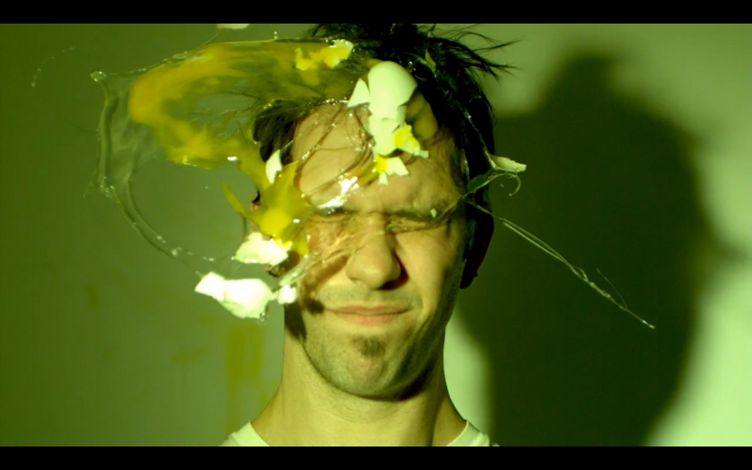


Slide 15
Questions?

